Slide 1
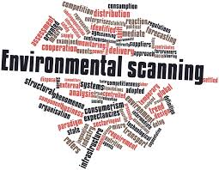

Slide 2
Environmental scanning
Careful monitoring of an organization's internal and external environment for detecting early signs of opportunities and threats that may influence its current and future plans.

Slide 3
Why do we need to scan our environment?
In a rapidly changing environment, one rule of thumb applies: If you don't adapt, you don't endure. This is the core idea behind environmental scanning.
The right information, combined with the right adaptations, can determine an organization's future viability. If an entrepreneur is not aware of the environment surrounding his/her business, he/she is sure to fail.

Slide 4
Importance of environment
Sensitivity to environmental factors is crucial for an entrepreneur. For example, Sony is failing to understand the changing trends in mobile phones and therefore losing it’s market share.

Slide 5
i) Identification of opportunities to get first mover advantage:
By keeping in touch with the changes in the external environment, an enterprise can identify opportunities and find strategies to capitalise on the opportunities at the earliest. For example, Volvo, the Swedish brand, has 74% share in the luxury bus segment as it had entered India earlier.

Slide 6
ii) Formulation of strategies and policies:
It helps in identifying threats and opportunities in the market. These can serve as the basis of formulation of strategies to counter threats and capitalise on opportunities in the market.

Slide 7
iii) Tapping useful resources:
If the company has a thorough knowledge of the external environment, it can tap raw materials, technology and even financial resources from the market at economical prices, at the right time.

Slide 8
iv) Better performance:
Proper understanding of the various elements of the external environment is necessary to take timely action to deal with threats and avail opportunities for the purpose of improvement in the performance of the firm.

Slide 9
v) Sensitisation of entrepreneurs to cope up with rapid changes:
A keen watch on the trends in the environment would help sensitise the entrepreneur to changing technology, competition, government policies and changing needs of the customers. For example, trends in clothing.

Slide 10
i) Image building:
If a company is sensitive to the external environment, it will come out with new products and services to meet the requirements of the customers. This would build the image or reputation of the firm in the eyes of the general public. For example, call–radio taxis with additional features like GPS systems, online booking etc

Slide 11
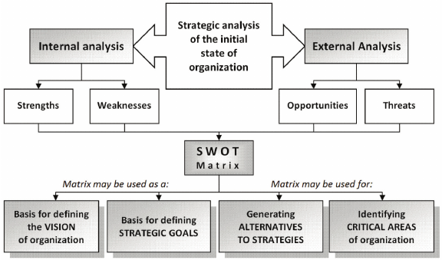

Slide 12
Analysis of environment
Environment analysis is the process of monitoring the economic and non-economic environment, to determine the opportunities and threats to an organisation.
a) verbal information from customers, wholesalers, retailers, distributors, consultants, etc.
b) records of companies .
c) government publications.
d) publications by various financial institutions. e) formal studies conducted by strategic planners.

Slide 13
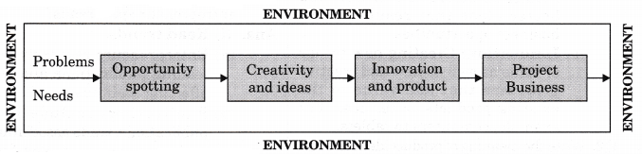
Environment scanning

Slide 14
Environmental factors
Entrepreneurship environment refers to the various forces within which various small, medium and large enterprises operate. These factors exert influence upon each other and do not operate in isolation. Business environment consists of two levels, i.e., micro environment and macro environment.

Slide 15
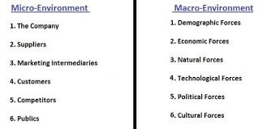

Slide 16
The PESTEL Model
Political: The political environment includes taxation policy, government stability and foreign trade regulations.
Economic: The economic environment includes interest rates, inflation, business cycles, unemployment, disposable, income, energy, availability and cost.

Slide 17
Social: The social/cultural environment includes population demographics, social mobility, income distribution, lifestyle changes, attitudes to work and leisure, levels of education and consumerism.
Technological: It is influenced by government spending on research, new discoveries and development, government and industry focus of technological effort, speed of technological transfer and rates of obsolescence.

Slide 18
Ecological: It considers the ways in which the organisation can produce its goods or services with minimum environmental damage.
Legal: It covers areas such as taxation, employment, law, monopoly, legislation and environmental protection laws.

